Slide 1
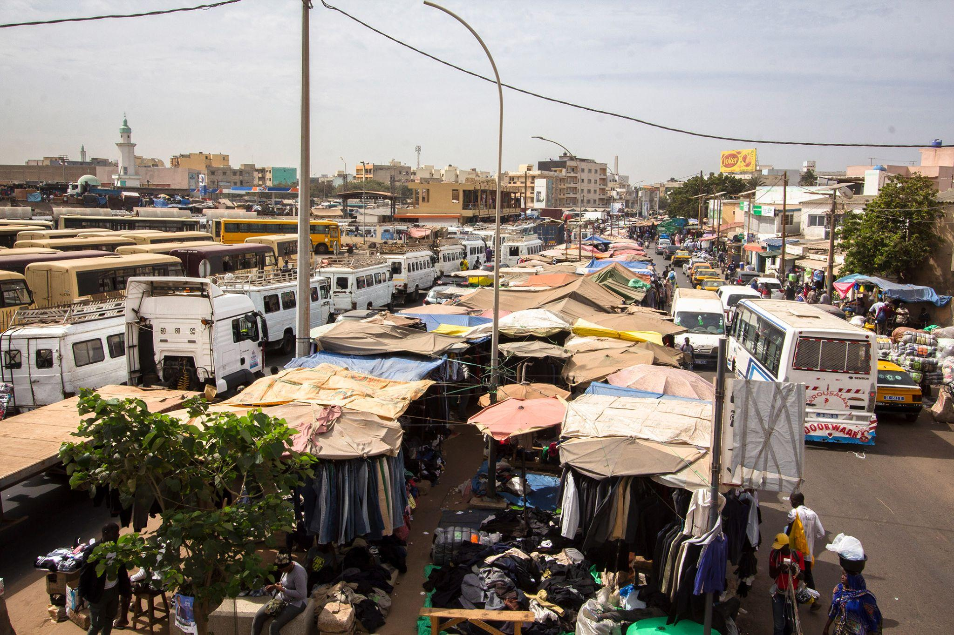
ALL YOU NEED TO KNOW ABOUT
INFORMAL CROSS-BORDER TRADE
by StreetNet International

Slide 2
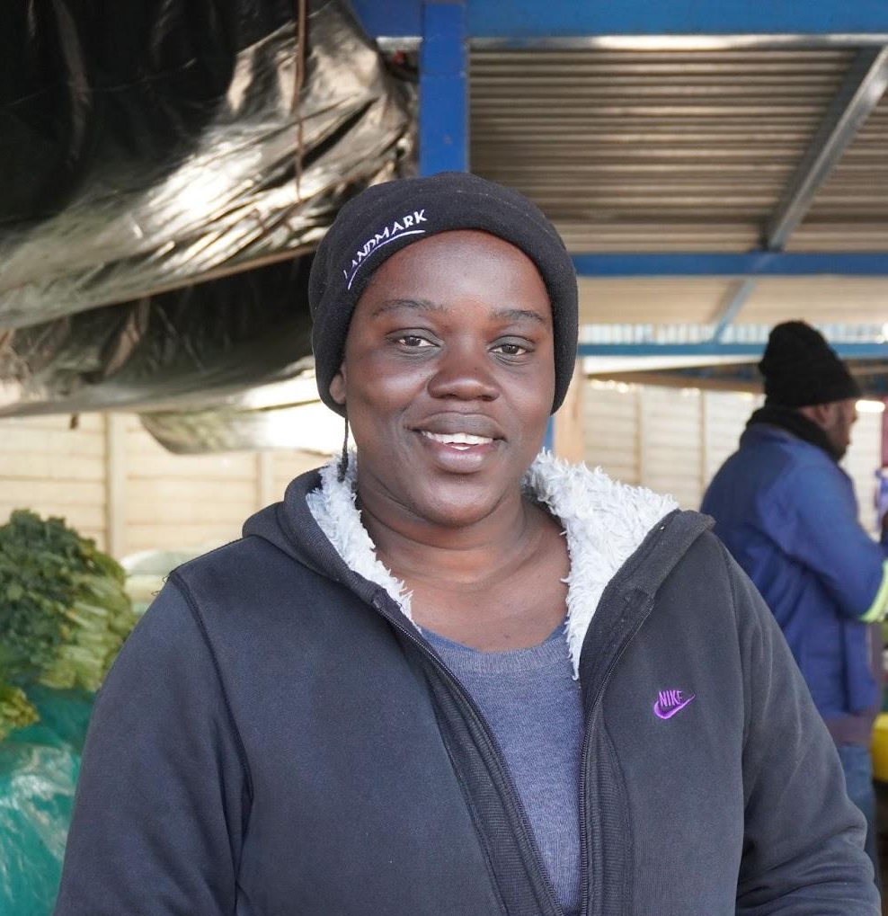
What is my work?
“I bring goods from Angola to Namibia to sell in the markets. Not many, just the ones I am capable of carrying in my luggage and transporting in buses shared with fellow traders, mostly fabrics and other non-perishable goods. Although I am constantly worried about what they will ask from me at the border, doing business this risky way is still the most lucrative option - in fact, for me, it is often the only option to be able to provide for my family”
Pictured: Sara Ngumba, Angolan cross-border trader in Namibian market

Slide 3
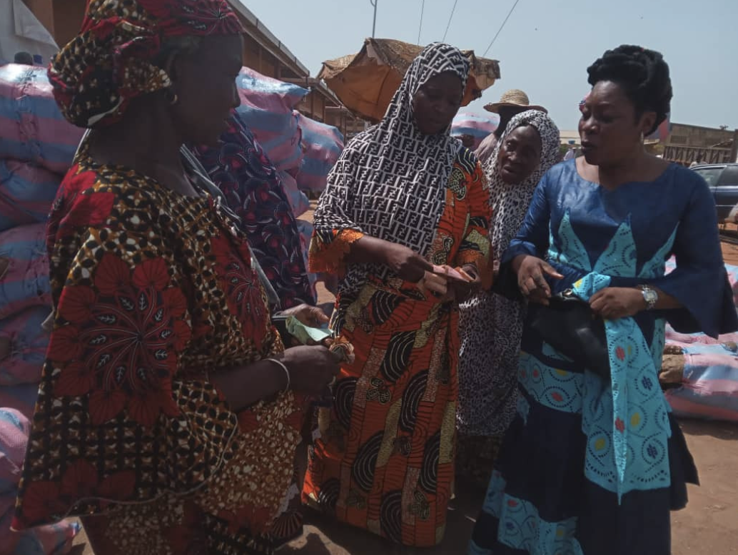
What is INFORMAL CROSS-BORDER TRADE?
According to the United Nations Conference
on Trade and Development, “informal cross-border trade is trade between neighbouring countries conducted by vulnerable, small, unregistered traders.”
Informal cross-border trade makes up for a large part of the informal economy worldwide, especially in regions such as Africa. A lot of informal traders sell goods across borders and face obstacles specific to their situation: to begin with, they are often not registered with authorities and are not recognized by the State. Like many other informal economy workers, however, they provide a vital contribution to their countries’ economies.
Do you know any informal cross-border traders? Are they members of your organization?

Slide 4
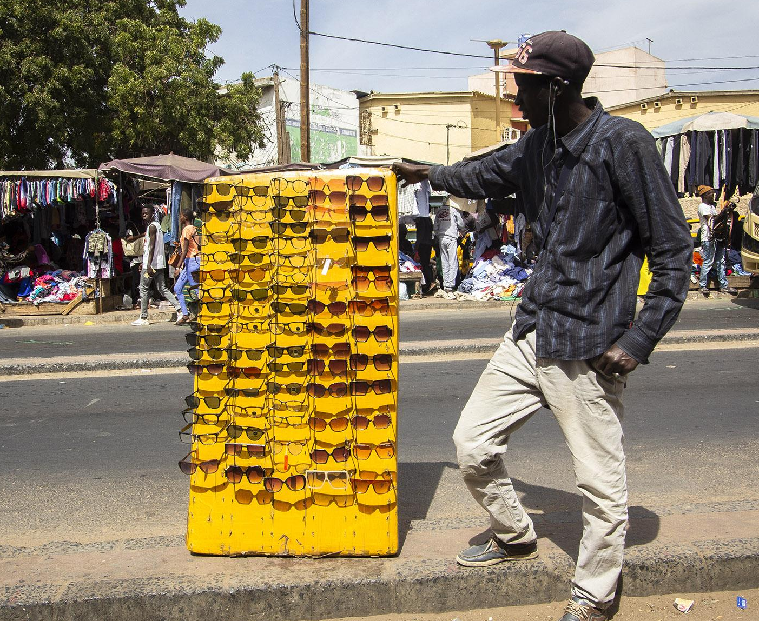
What are common challenges faced by traders?
What are the main problems for informal cross-border traders in your region?

Slide 5
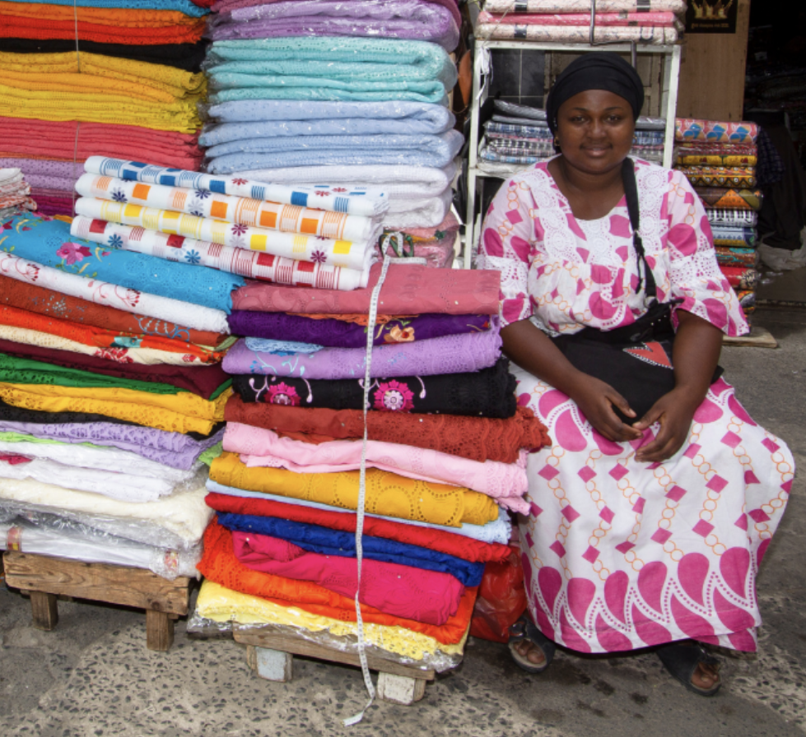
What are common challenges faced by traders?
Our affiliates in the West & Central Africa region identified the following ones:
Extreme lack of transparency and accountability in bureaucracy
Corruption and extortion (illegal fees are often demanded from cross-border traders)
Confiscation of goods and risk of loss of livelihood
High fees and taxes
All forms of Harassment
All forms of Violence
Gender-based violence (e.g. sexual assault)

Slide 6
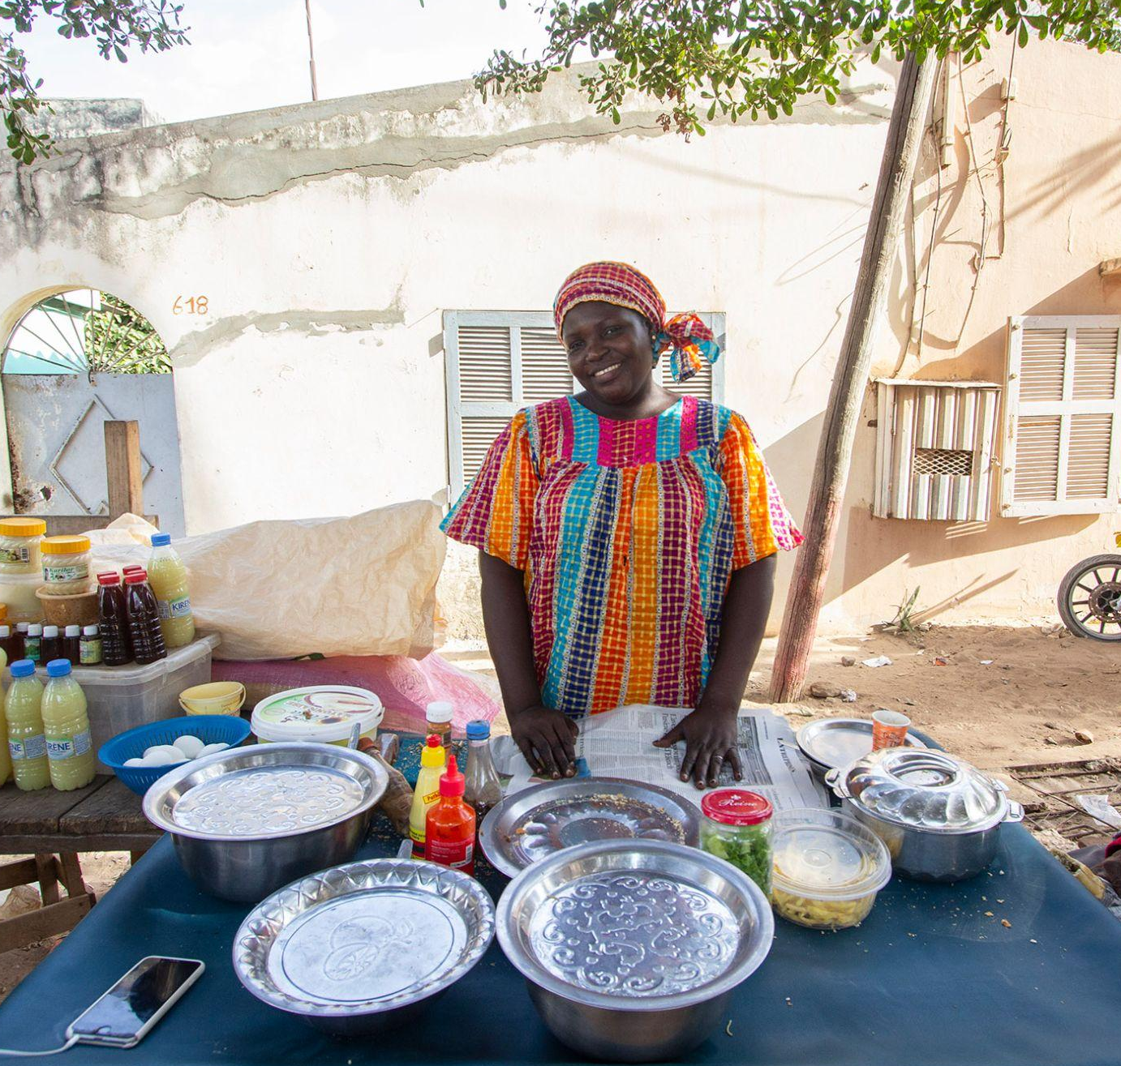
Informal cross-border trade: a woman’s job?
Did you know? In Africa, an estimated
70% of informal cross border traders are women (Source: FAO, 2017)
“It offers the only opportunity for women to enter the world of work and earn a livelihood, take care of their families and interact socially and economically with others. For most women in the border communities, cross-border trade offers the only means of earning some subsistence.”
Gbenga Komolafe, Secretary General of the Federation of Informal Workers Organisation of Nigeria
Is this a reality in your country? Do you have women informal cross-border traders as members?

Slide 7
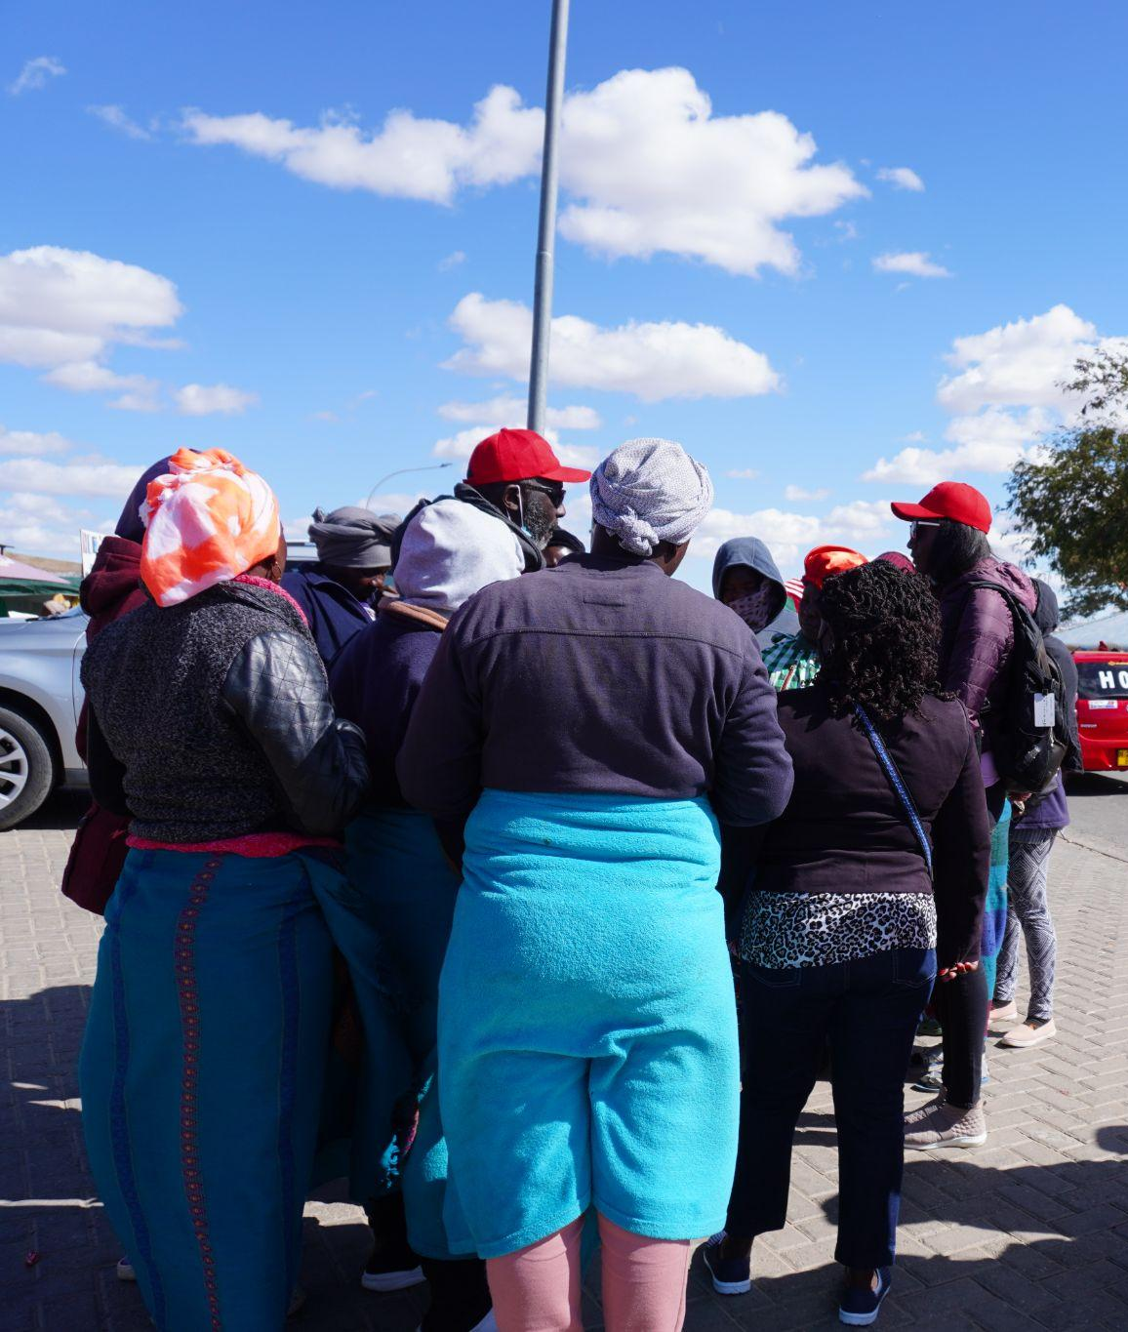
A potential solution: simplified trade regimes
Simplified trade regimes are specific agreements, first implemented in 2010 by COMESA (Common Market of Eastern and Southern Africa) allowing a significant reduction of the bureaucratic burdens for traders that sell up to a certain value of goods ($2000 per day) across the borders.
It is estimated that 90% of beneficiaries of such simplifications are women.
Simplified and special trade regimes can succeed where standard free trade agreements for movement of goods and people fail: in protecting the most vulnerable.
Do you know of any kind of simplified trade regimes in your economic region?

Slide 8
Researching informal cross-border trade in your region
Before starting to work on informal cross-border trade, it is important to understand the context in your particular organization and then from your country/region. The demographics of informal cross-border traders is very important, as well as their routes and working places, the borders in which they operate, and so on.
You must also reflect on the trade agreements in your region and whether they have provisions for cross-border trade.
Finally, you must engage cross-border traders directly and/or their representatives to understand what the issues are and what they propose as solutions.

Slide 9
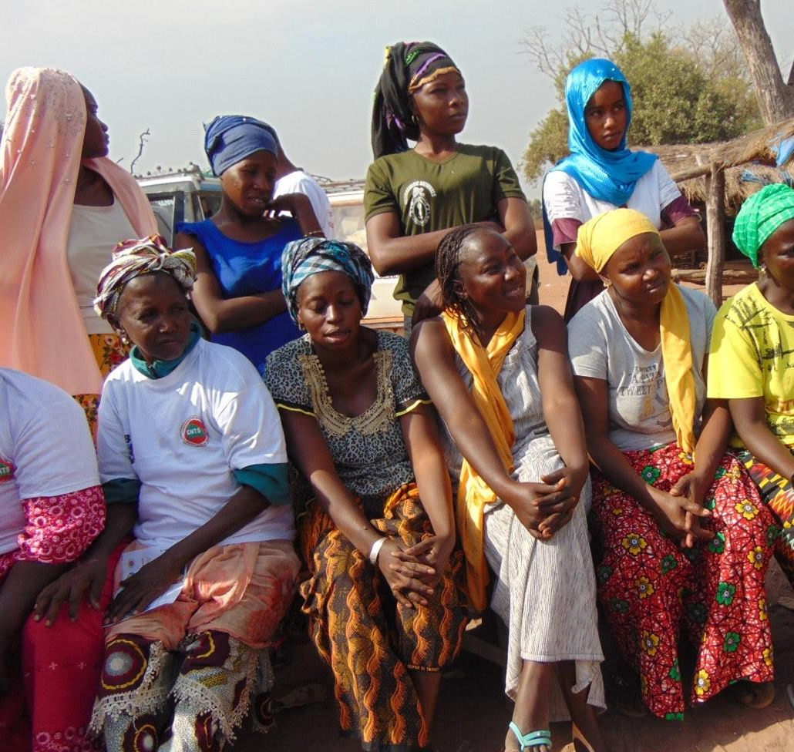
Our affiliates’ demands
In 2021 and 2022, StreetNet implemented a project with its affiliates from the West and Central Africa region to promote and advocate for the rights of informal cross-border traders.
During the project, based on qualitative research conducted by affiliates, they came together to draft demands regarding informal cross border trade according to key areas of concern:
Stop harassment and violence
Access to rights and support
Heavy Taxation systems
Policies and regulation
Inclusive negotiation

Slide 10
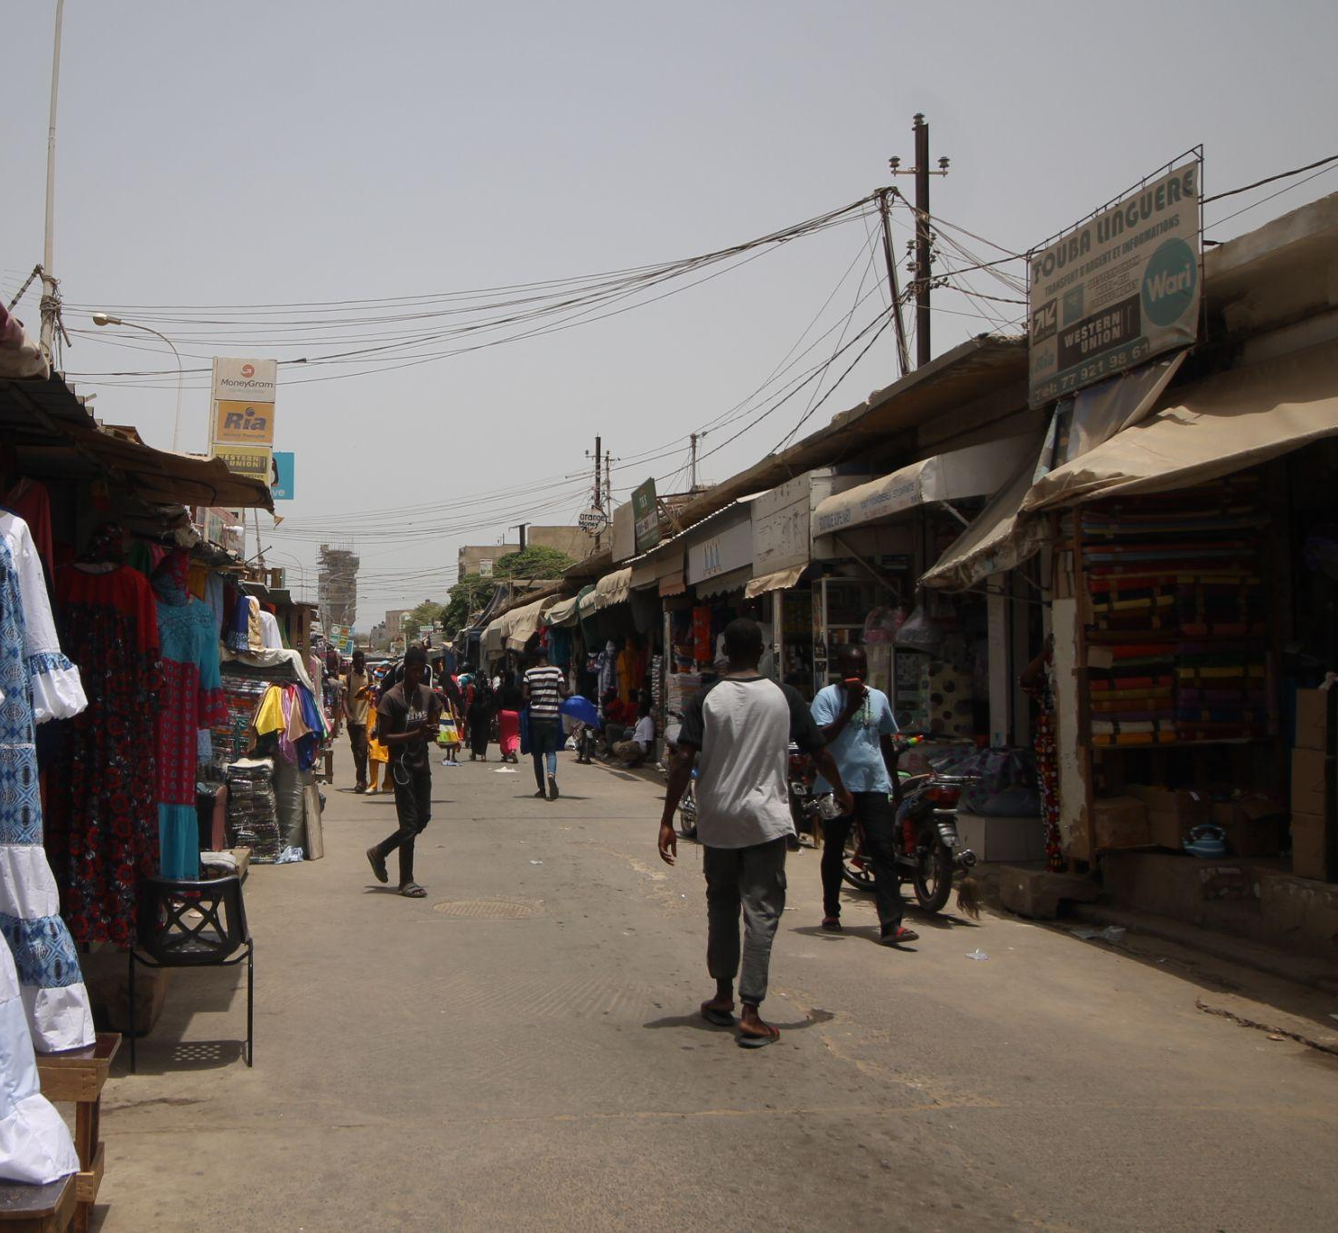
Demands: stop harassment and violence
Decency and dignity in treatment at border posts when authorities are engaging cross-border traders;
End all forms of intimidation and harassment to which traders become victims
Ban on extortion;
Put an end to the various harassments of which traders are victims;
Security for traders and their goods;
Provide facilities for women who engage in cross-border trade;
Clean up the customs and police corridors of certain countries and make them respect the regulations established in regional trade agreements.

Slide 11
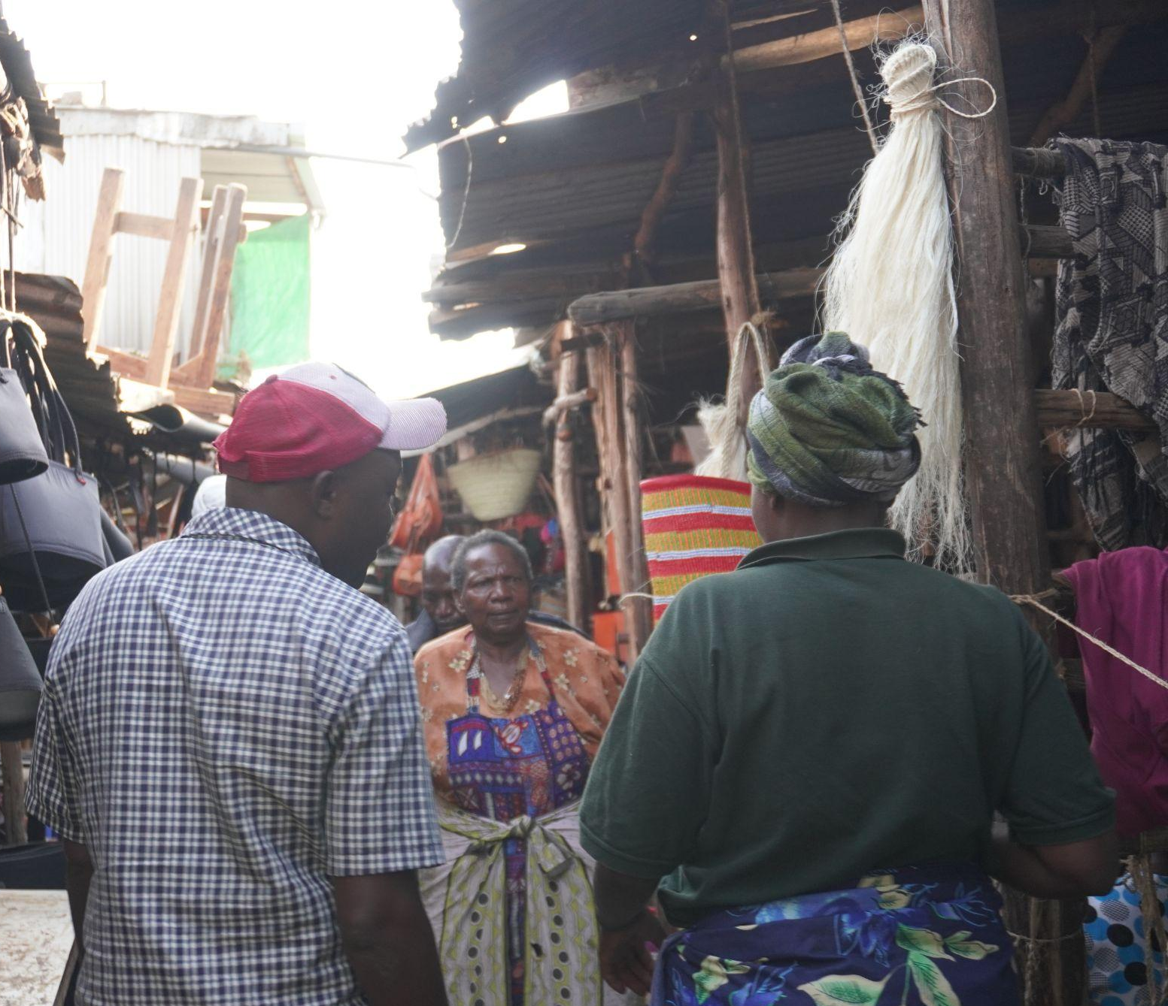
Demands: access to rights and support
Identifying & organizing all ICBT across our countries which are not recognized or organized;
Promotion of Social Protection, workers’ rights and active/participatory social dialogue;
State provision of informal cross-border traders’ loans with reasonable interests/grants to enable them to restart their businesses where there have been casualties and losses on the borders due to abuses suffered;
Psychosocial support for cross-border traders especially those who lost their jobs within the COVID-19 period.
Promotion of ILO recommendation 204 and formalization of activities and recognition of informal economy actors.

Slide 12
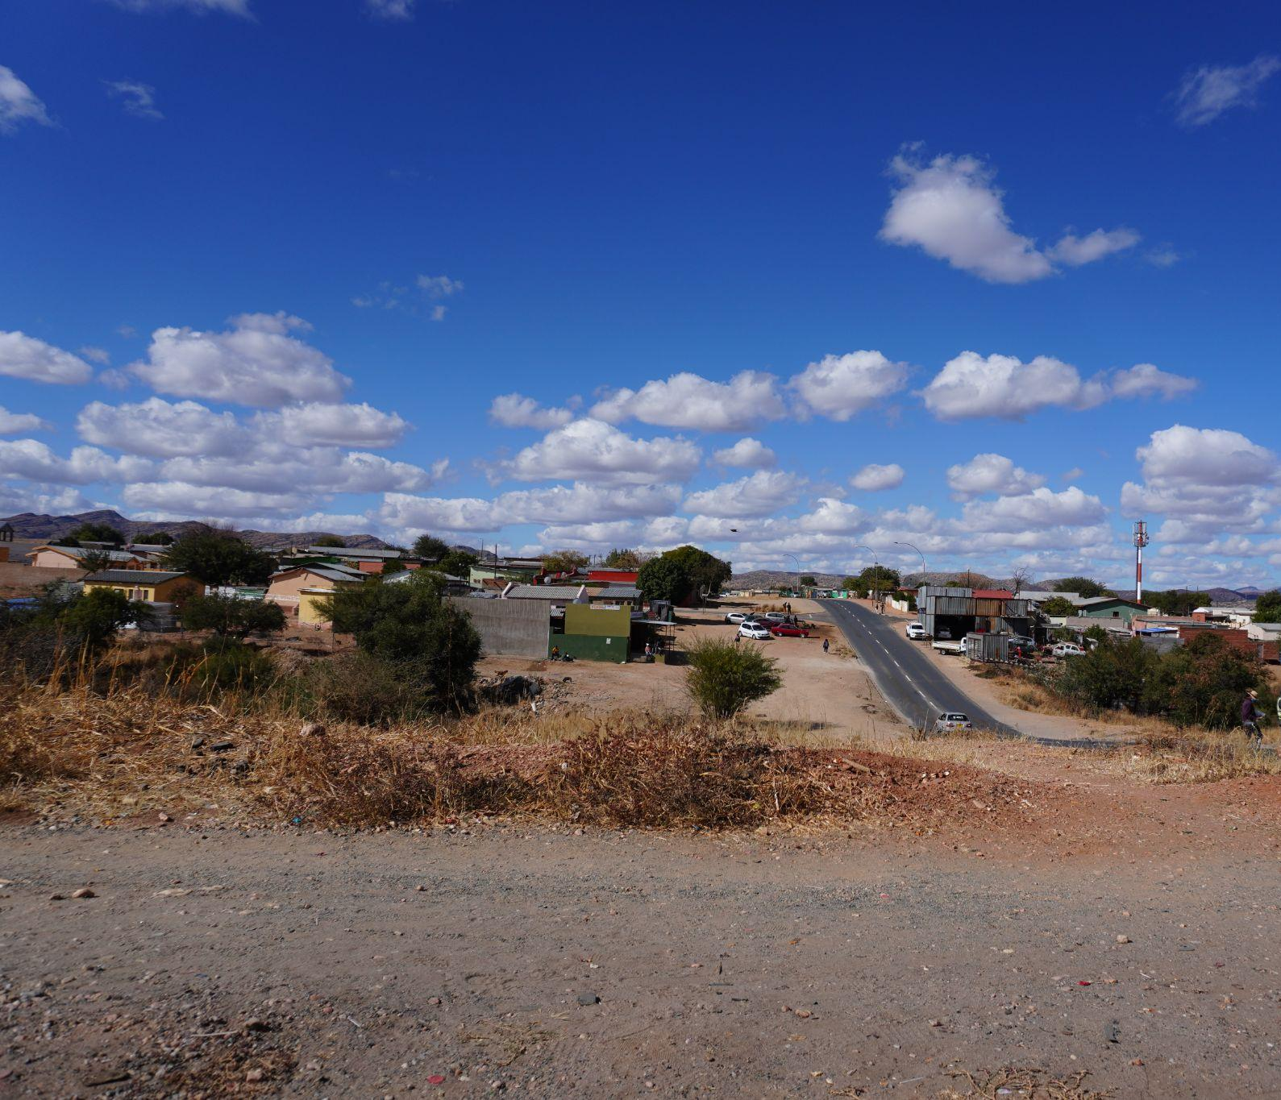
Demands: taxation
Custom Tariffs harmonization at border post to allow for free movement of people and goods;
Access to certificate of origin to cross-border traders;
Simplified custom tariffs at all entering post of our borders;
Everything concerning goods i.e., paying of duty, checking goods and other relevant documents are carried out at one particular point.;
Special tellers for informal traders with fast tracked declarations/transactions without extortion at borders;
A border access document is available;
Significant reduction of taxes within borders;
Exchange of different currencies;
Reduction of customs duties on quantities and specific products.

Slide 13
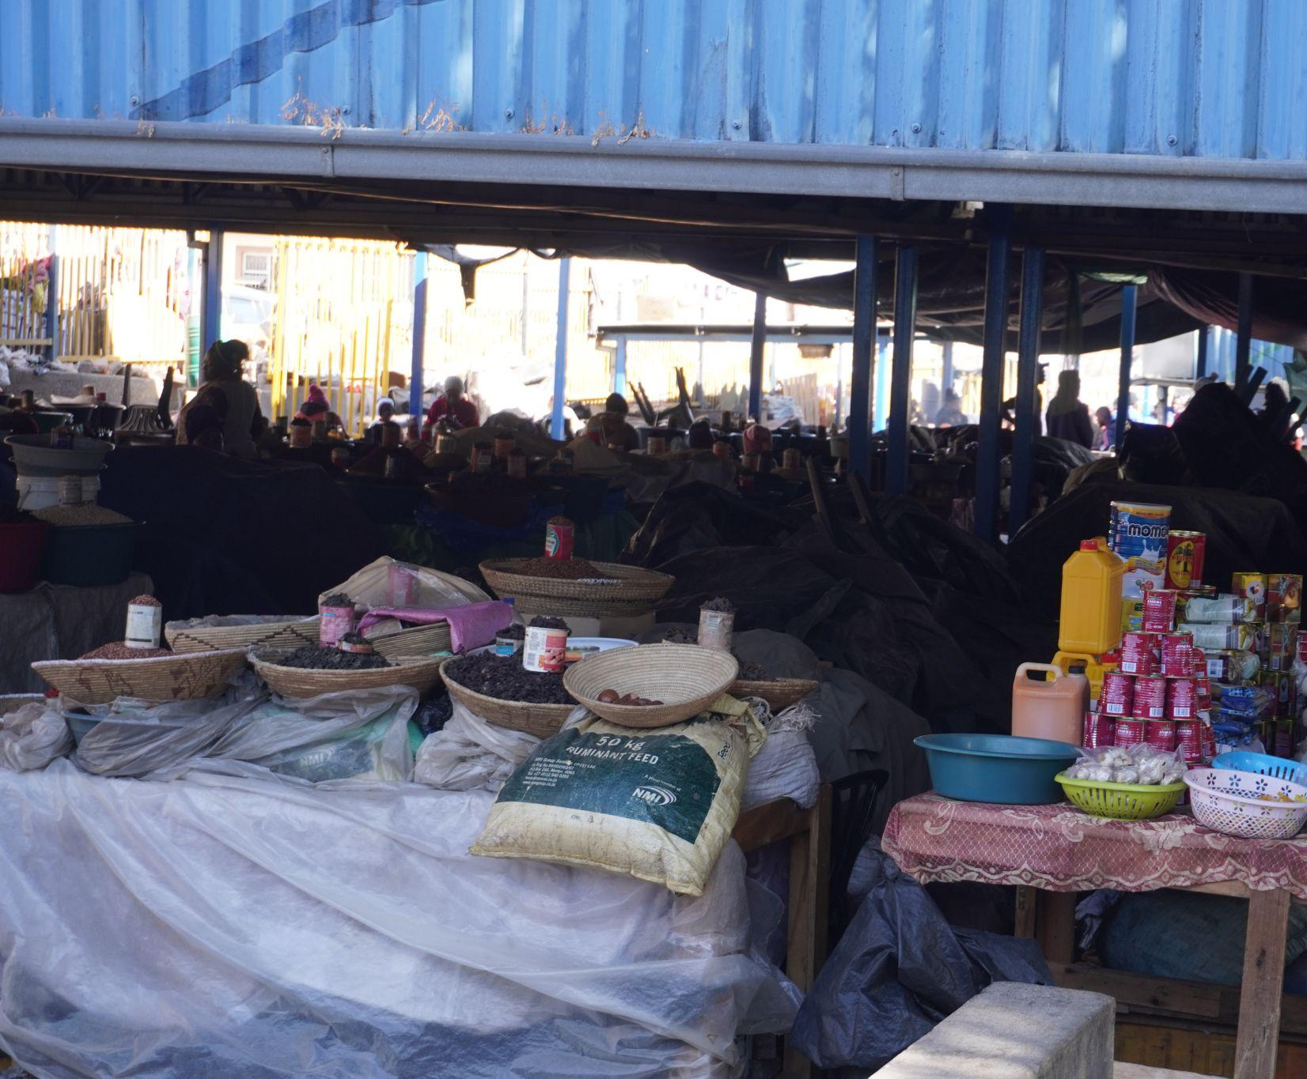
Demands: policies and regulations
Compliance with existing regional trade agreements;
Close monitoring of harmonization of regulations;
Proper documentation allowing easy crossing of the border through legal routes;
Ratification of international documents and instruments to facilitate trade in sub-regions.

Slide 14
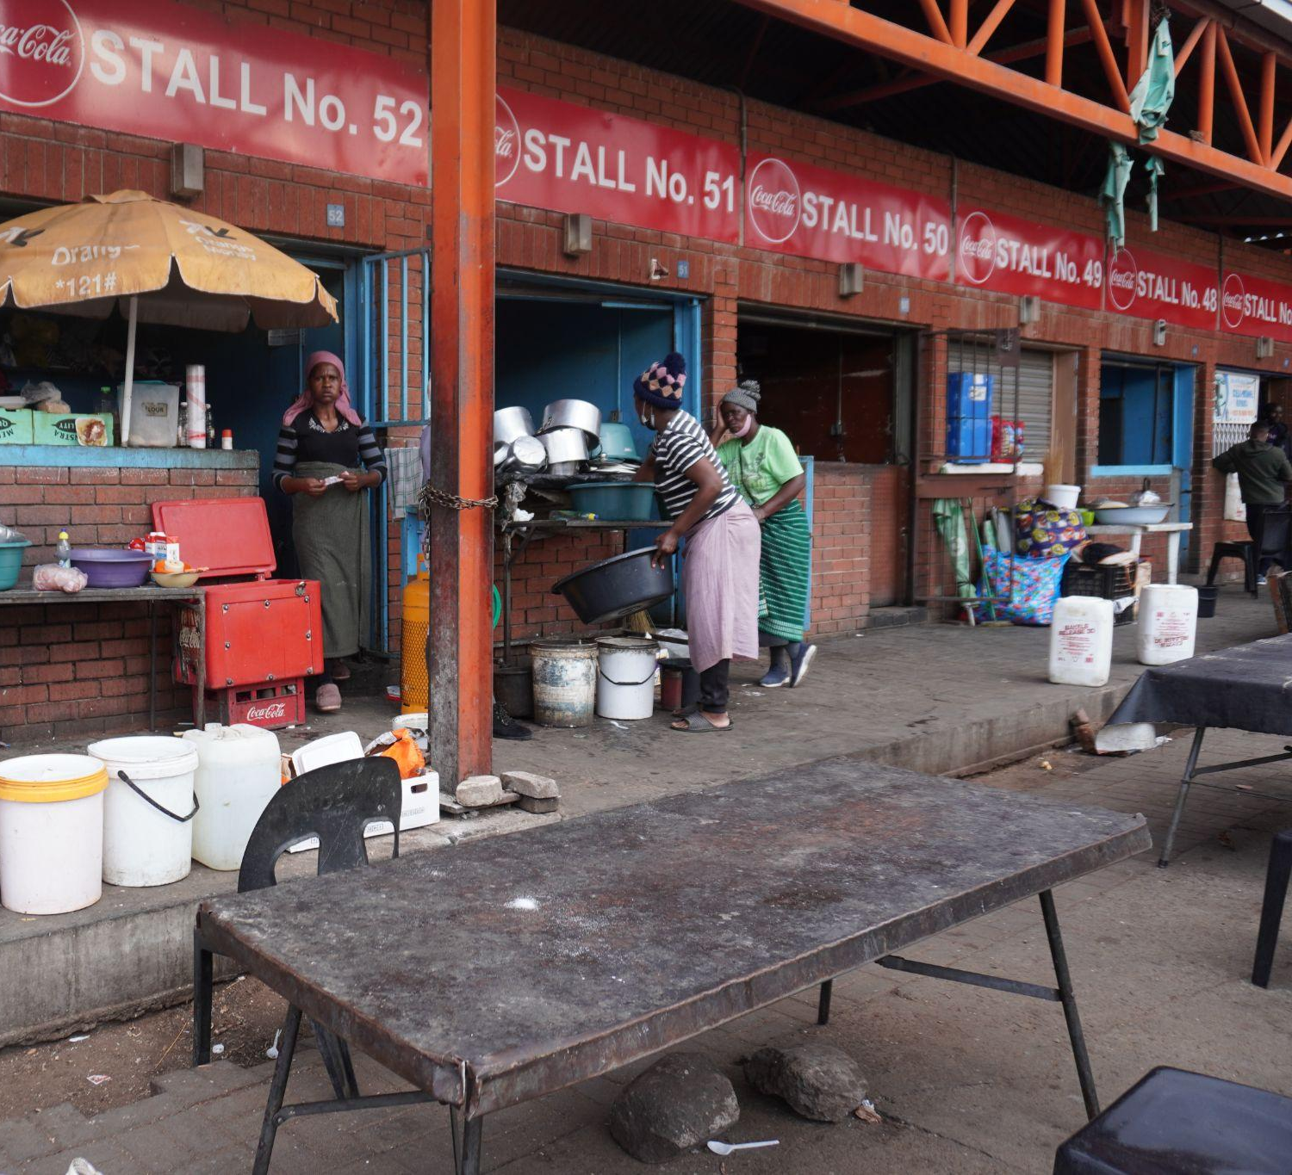
Demands: inclusive negotiations
Creation of a dialogue platform of decision-making forums.;
Create a framework for consultations between related stakeholders who work at the borders of neighboring countries;
Establishment of a border listening and guidance office for traders;
Establishment of a bipartite consultation framework (Government-Trade Union/Informal Traders’ Association).

Slide 15
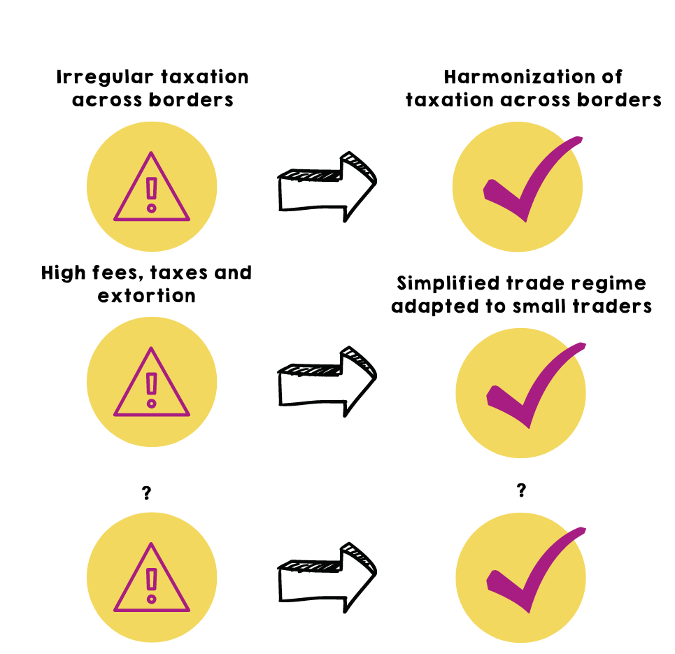
From challenges to demands | Problems & Solutions
If you think of the problems you mentioned before regarding your borders, can you identify solution for each?

Slide 16
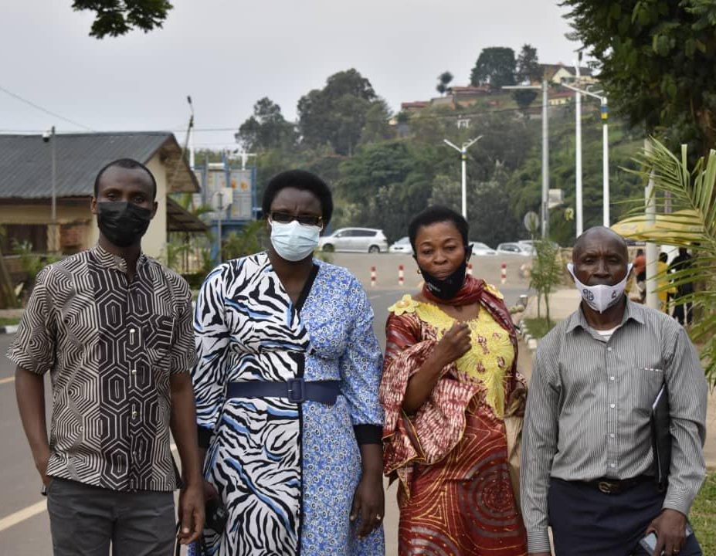
How should you negotiate for these demands?
The “Three Golden Rules” in any negotiation:
1. Never Negotiate alone and always ensure cordiality with officials/partners;
2. Never make a deal without agreement of members. Always insist on a signed agreement where possible)
3. Maintain unity while negotiating.

Slide 17
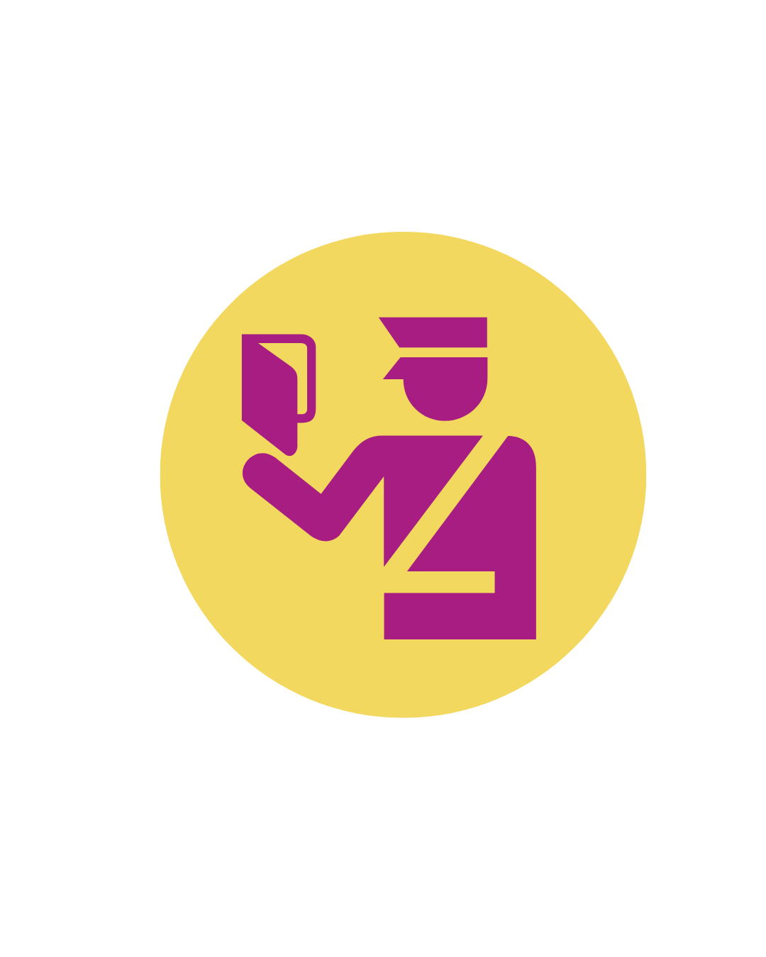
Who is on the other side of my border?
Informal cross-border traders, by definition, cross border regularly.
Therefore, you cannot resolve their issues only by acting in your country.
You must identify the issues according to each border and engage authorities from both sides.
But you should not do this alone - StreetNet affiliates must come together and engage jointly in advocacy and negotiations. Only together can we be successful!
Also look out for partners who can support your advocacy.

Slide 18
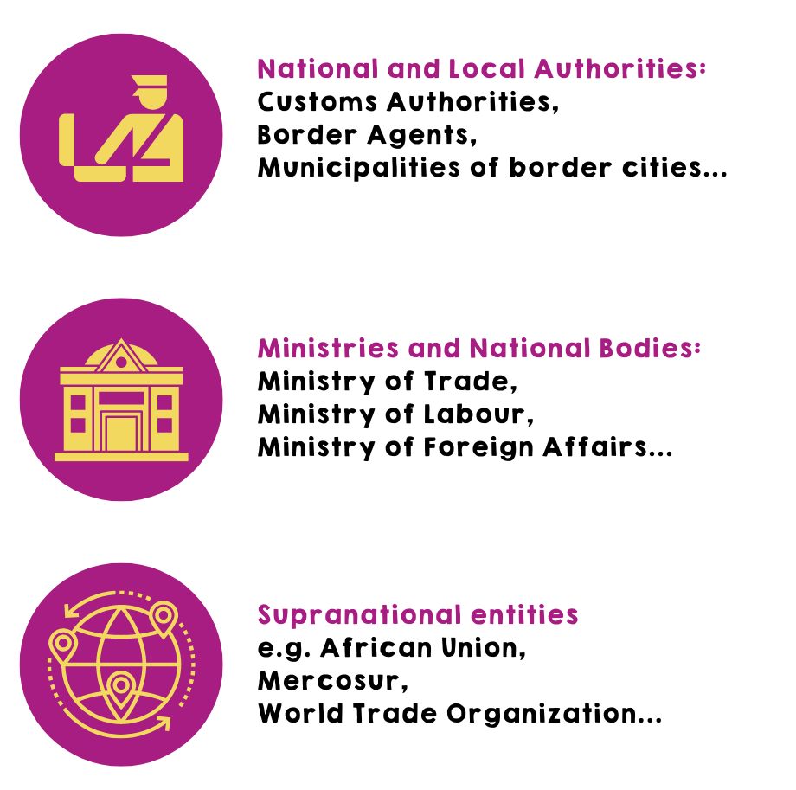
Who should I negotiate with?
Who you negotiate with depends on the contexts of each side of the border.
Maybe in one country you should contact customs authorities, but in the other you should go directly to the Ministry of Trade.
Perhaps you are advocating for a broader regional policy change, and therefore must reach out to supranational entities/partners. Those in the ECOWAS sub-region worked with Organization of Trade Unions of West Africa (OTUWA) and ITUC-Africa for instance.
A joint analysis of stakeholders based on your demands is crucial to identify who is/are your negotiation counterpart(s).
Who would you engage in your country for negotiations?

Slide 19
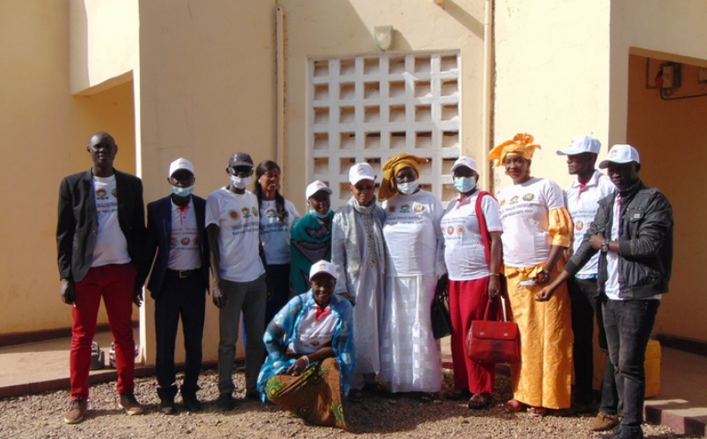
Examples of negotiation & advocacy activities
CNTG & CNTS : A delegation from Senegal traveled directly to Guinea, and the first meeting was held in the city of Koundara. The administrative authorities, particularly the mayor and the prefect, encouraged the delegation to continue their activities in the region. They accompanied the Senegal delegation to meet the comrades from Guinea with the customs authorities, the police and the border service. The two organizations held a 4 hours advocacy meeting with the authorities in Guinea. This meeting helped to shed light on many difficulties ICBT workers are faced with. The authorities proved their support as they expressed interest at working to improve the situation.
FOR MORE EXAMPLES, DISCOVER OUR ICBT ADVOCACY PLAYLIST WITH ANIMATION VIDEOS REGARDING EACH NEGOTIATION UNDERTAKEN BY OUR AFFILIATES IN WEST & CENTRAL AFRICA:
https://www.youtube.com/playlist?list=PLjssOqZXgc06-LY-aZ6WUX6ANB6_9Jzmk

Slide 20
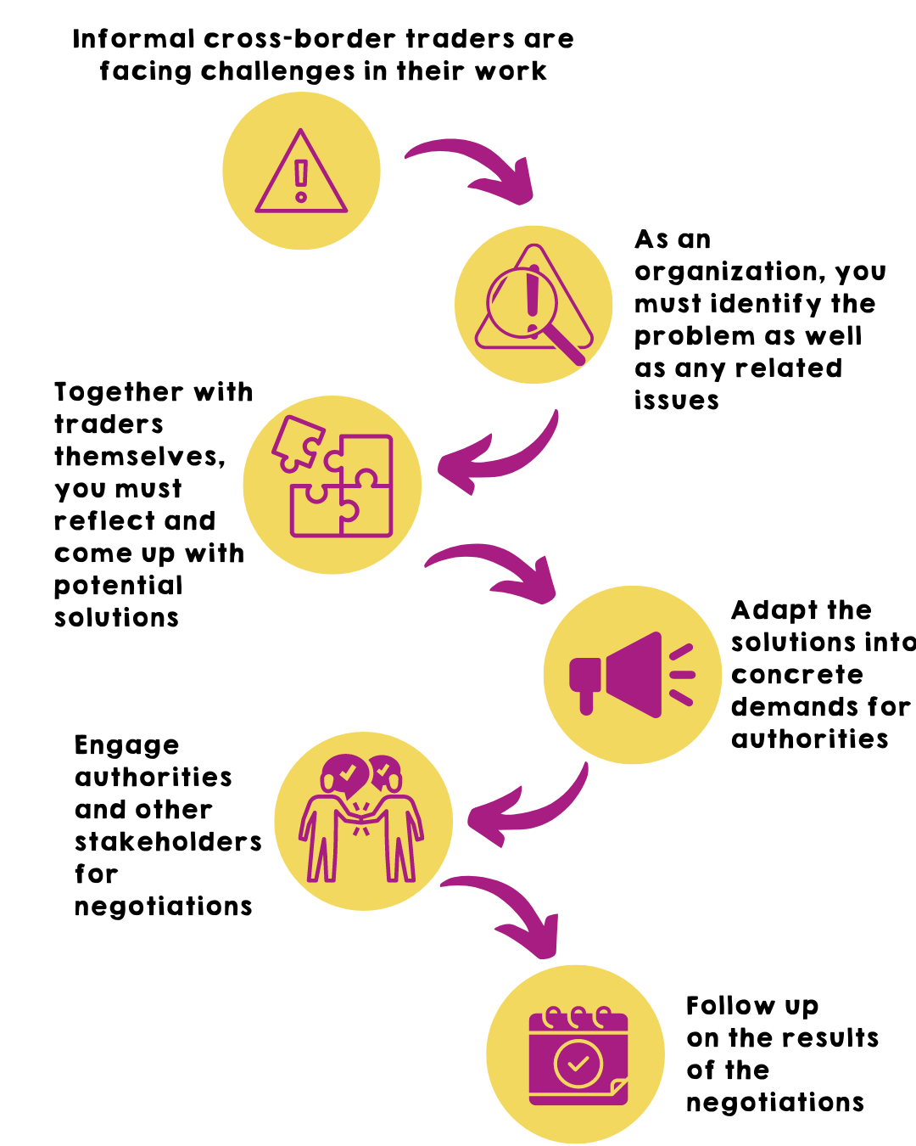
ICBT Project: how it will work
Through this project, we are encouraging you to learn more about informal cross-border trade, to identify problems, come up with solutions and present clear demands to stakeholders during negotiations, with your fellow StreetNet affiliates across the border; and other partners.

Slide 21
Questions?
Do you have any questions?

Slide 22
Committing to a plan and working together
After this presentation, we highly encourage you to reach out to fellow StreetNet affiliates and start discussing how you can prepare joint negotiations across your borders.
Remember that StreetNet is here to support you!

Slide 23
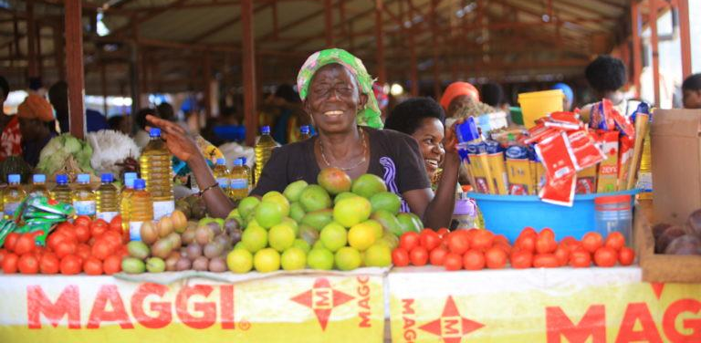
THANK YOU!

