Slide 1
Commission: Climate Change, the Just Transition and Access to Public Space

Slide 2
Question 1
● How has extreme weather and/or pollution impacted your and your members work?

Slide 3
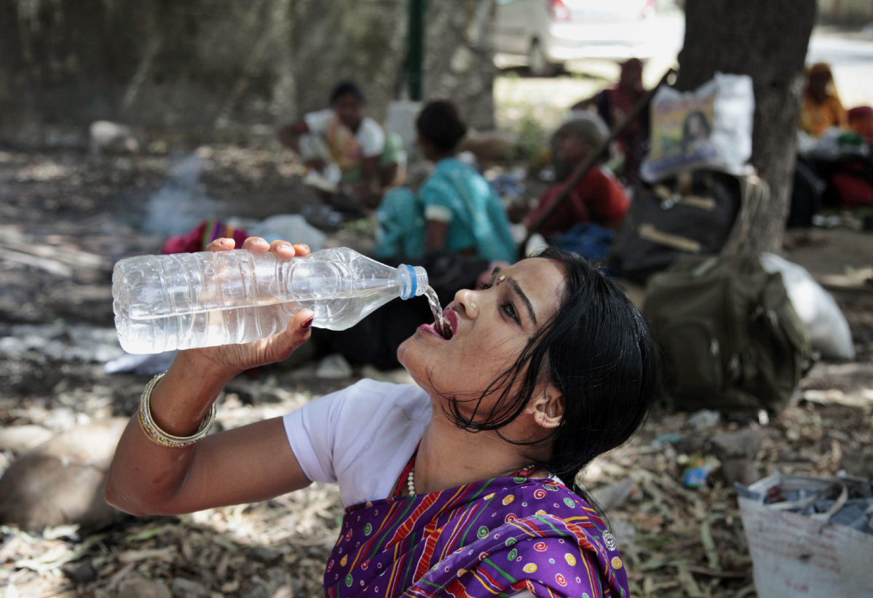
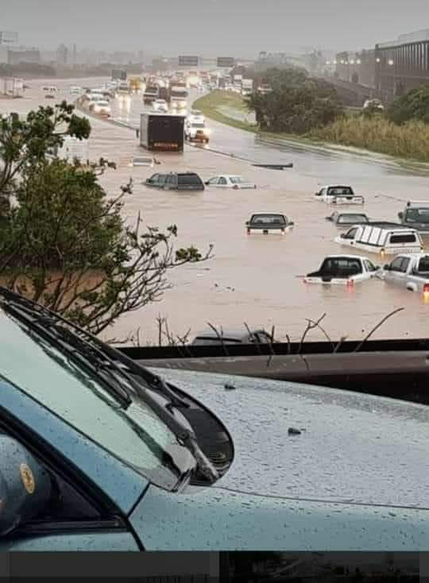
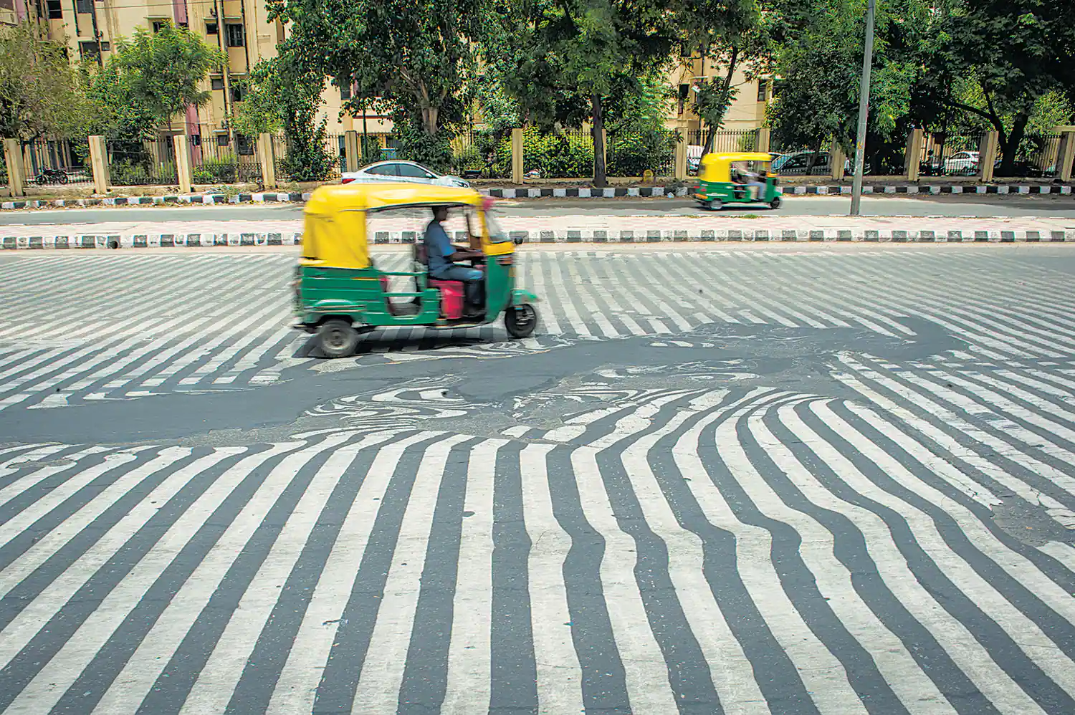
Research on Climate Change Impacts on Vendors
Negative impacts on health, workplaces, sources of supply (especially fresh produce) & homes.
National and city level climate mitigation and adaptation policies are blind to vendor needs.
Climate crisis resources are not allocated to informal workers.

Slide 4
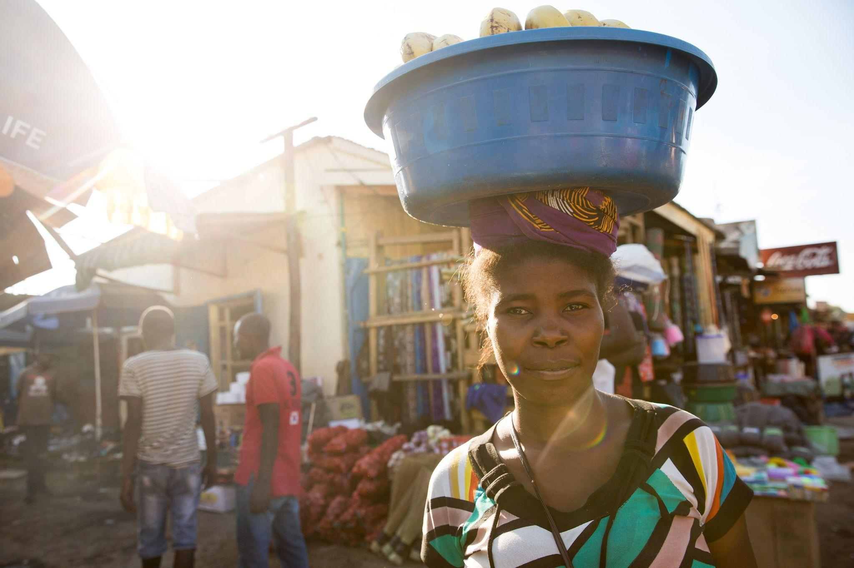
Vendors as Climate Change Agents
Often distributing local goods and services.
Have a comparatively small carbon footprint.
Are part of zero waste initiatives - waste reduction, composting and waste recycling.

Slide 5
Vendors & Climate Change & the Just Transition
Strengthen street vendor and market traders calls for:
Social protections - health care, social insurance
Appropriate work infrastructure - water, sanitation, shelter and storage
Slum upgrading
Access to adaptation and mitigation funds.

Slide 6
International Commitments
United Nations Sustainable Development Goal 11
‘By 2030, there will be universal access to safe, inclusive and accessible, green and public spaces’ (Target 7).
UN Habitat New Urban Agenda
‘We commit to promote safe, inclusive, accessible, green and quality public spaces...that are multi-functional areas for social interaction and inclusion, human health and well-being, economic exchange …’ (UN Habitat 2016: 37).
International Labour Organization Recommendation R204 on Formalising the Informal Economy
‘local development strategies need to include ‘regulated access for use of public space … for subsistence livelihoods’ (2015, 11,o).
Together this constitutes an unprecedented global commitment to regulated access to public space for informal workers.

Slide 7
Arguments & Evidence to Strengthen Advocacy
Calculating contributions to:
Employment (in general and women in particular)
Economic growth
Food security
Urban management - crime prevention and cleaning
Climate change mitigation

Slide 8
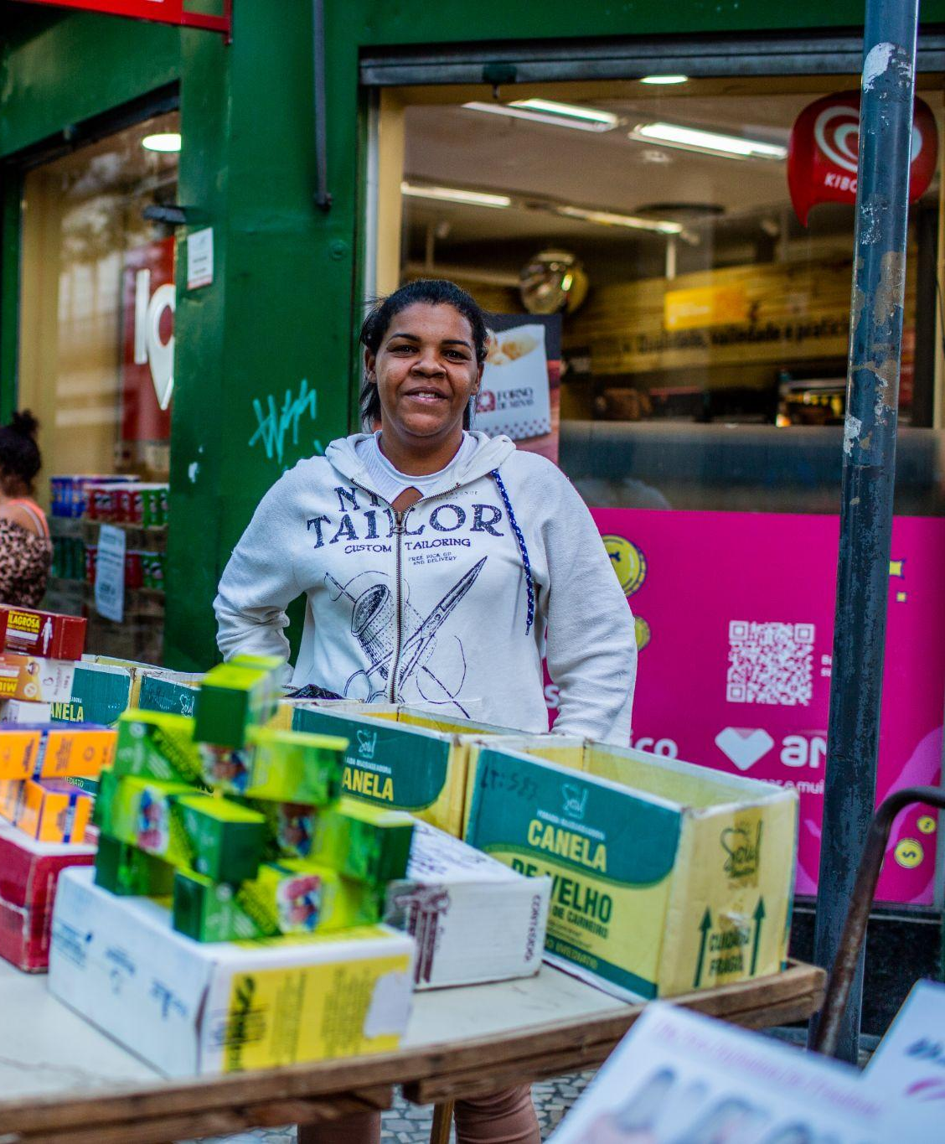
Tools to strengthen access to public space
Legislative Frameworks
At national level: India’s Street Vendor Act
At local level: Street vendor bylaws
making use of administrative justice principles
Negotiating Forums
Establishing regular forums with local / national authorities where issues can be proactively and jointly addressed.
Demonstration Projects
‘Art of the possible’ in management and infrastructure provision.

Slide 9
Part 2: Discussion Questions
Who will advance SNI and its affiliates access to public space and infrastructure?
Who will hinder access to public space?
Who should SNI and its affiliates target as a priority and why/when?

Slide 10
Part 3: Discussion Questions
What is the change you would like to see in the next 4 years?
How do you bring about that change?

